Slide 1
Need for Sitecore Connect in a Version less Composable World
Pushpaganan Nagarajan

Slide 2
AGENDA
Integration Workbench developed in partnership with Workato
Terminologies
Connections
Recipes
Triggers
Actions/Tasks
Need for Connect…..
Maximum connectivity with minimum overhead
Flexible data transfer points
……..In a Version Less Composable World
Composable Apps
Complex Applications
DEMO

Slide 3
​Monolithic | Composable
Like the old ALL IN ONE TV/VCR Set
Modern TV Home Theatre System
Notes:
Before using the usual analogy Legos wanted to create a simple picture of Monolithic Vs Composable
All in One TV/VCR is good until… You want to increase the TV screen size, or you don’t want Video Cassette Player anymore.
Modern TV Home Theatre System where you can connect any TV with any Audio System as long as you have a HDMI port.
For TV this make sense but for an enterprise?

Slide 4
COMPOSABILITY
What common item can be used to construct a house, a tree, and a car?
The answer, which may not be obvious, is LEGO bricks. LEGOs are a fantastic example of composability, which is the ability to combine smaller, modular components to create a greater, more complex product. This concept of composability also applies to business, where companies are leveraging composable architectures to remain competitive and agile in the age of digital transformation.
“For a composable enterprise, composability is a design approach that involves breaking down software or hardware systems into smaller building blocks that can be easily modified, updated, or replaced to meet specific business needs. This approach creates a fluid work environment that champions individual components without having to overhaul an entire system.”

Slide 5
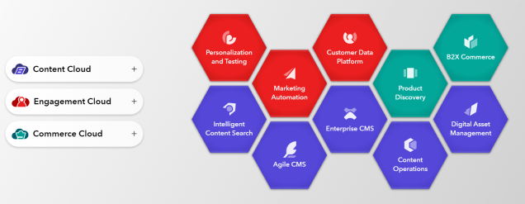

Slide 6
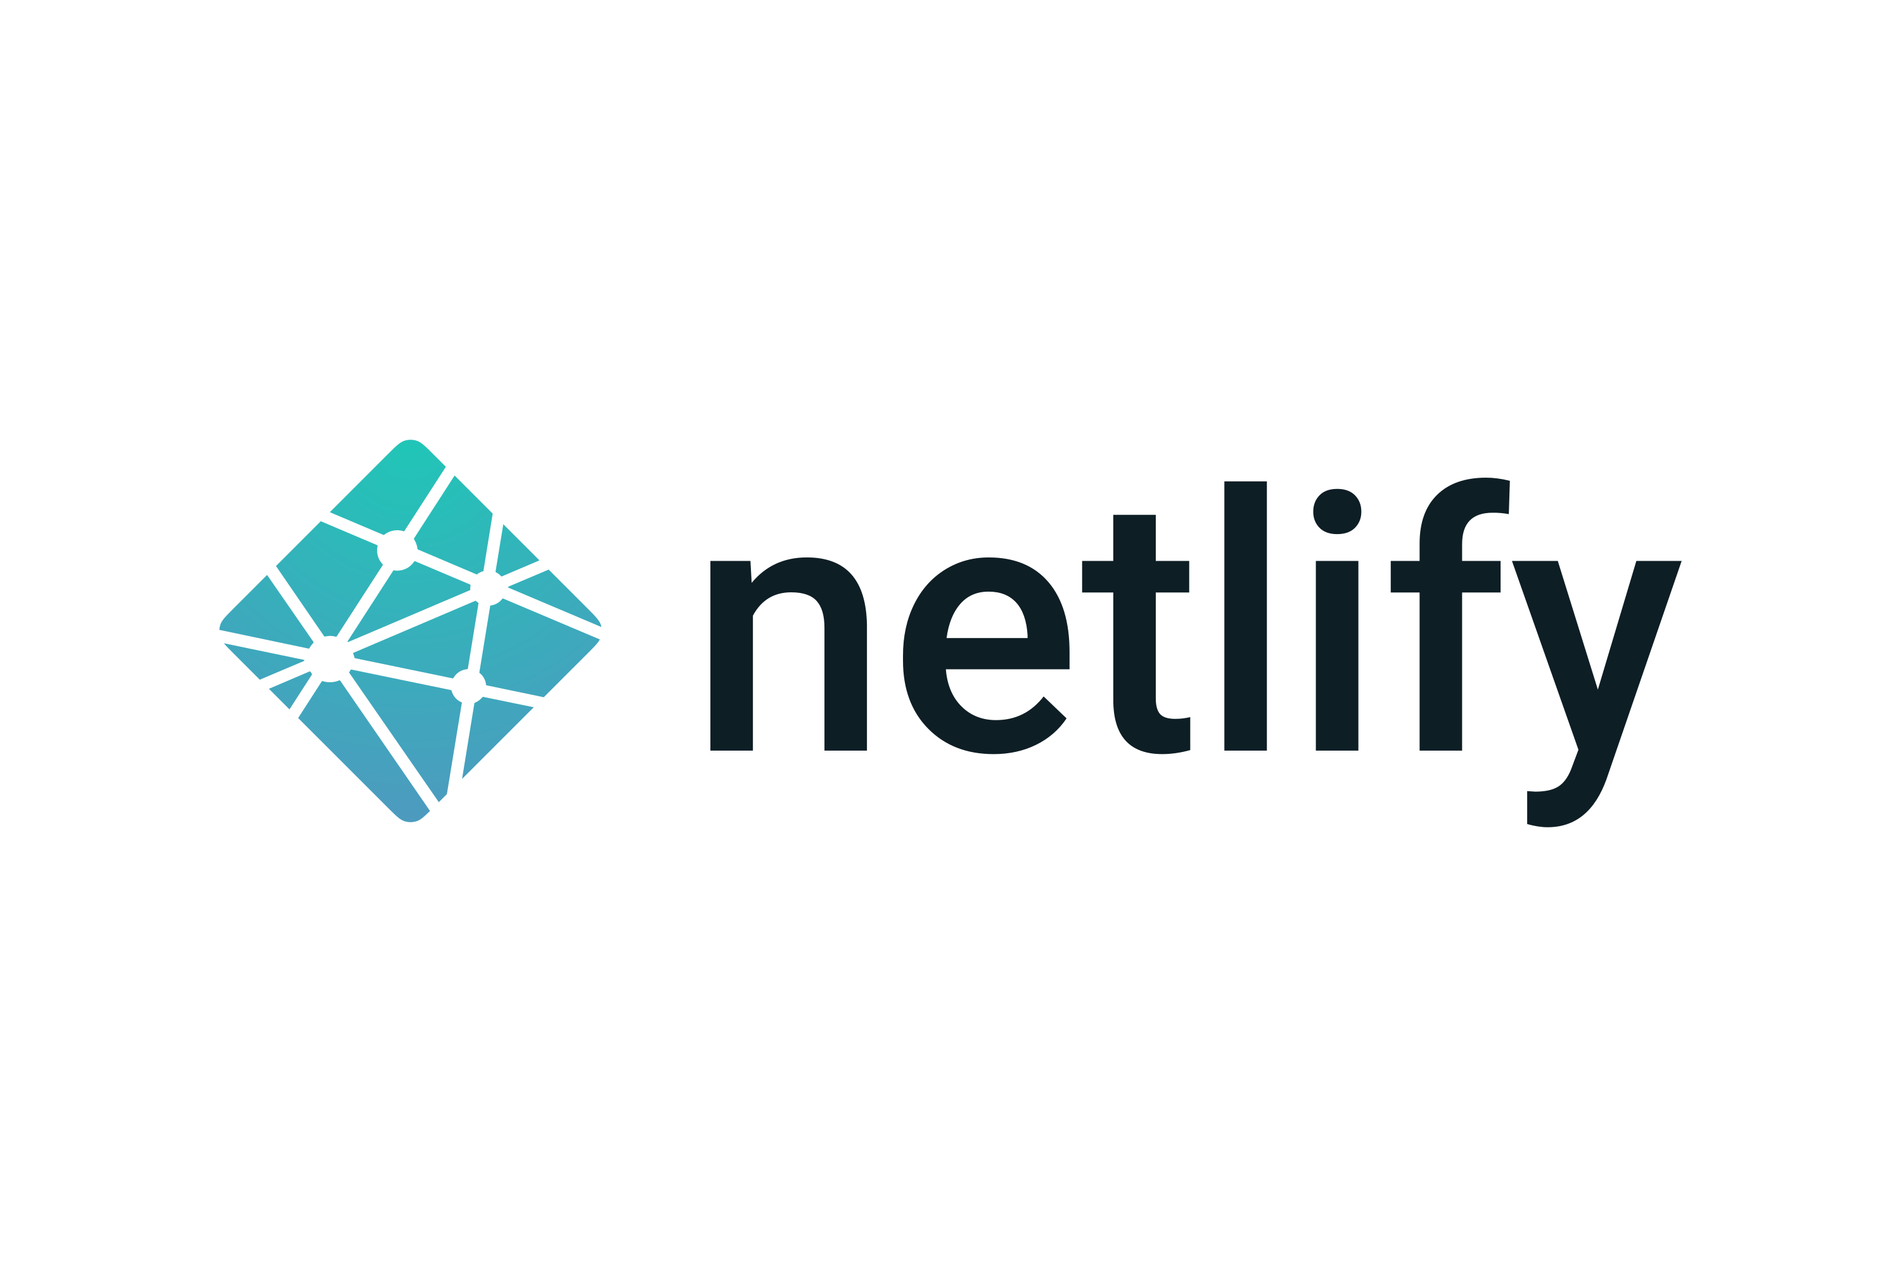
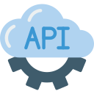
Content
FE Framework
CI/CD &
HOSTING
WEB
/
MOBILE
A
P
P
L
I
C
A
T
I
O
N
S
XM Cloud
(Headless SaaS)
ContentHub One
Deploy
(Headless SaaS)
Any Headless CMS
APIs
CDP
Personalize
Search
Send
Identity Management
Analytics
Notes:
I didnt include the Repository/Build/Release – TC,Octopus,Azure Devops kinda boxes intentionally here
Customer Data Platform – Customer Data Management, Customer Profiles and Segmentation etc Personalize – Decision Engine, Experiment & Optimize, Experiment Control and Engage (Data Lookups, A/B testing, Goal Based Reporting etc)
Search – SaaS Search Alternative Search – Azure Search, SearchStax
Send – Cloud-based email marketing software product. You can use Send to create, automate, and manage your email campaigns. Alternatively – HubSpot, OmniSend

Slide 7
Sitecore Engagement Cloud focuses on integrating and organizing customers data to deliver optimized and personalized experiences in different channels.
2023
7
Notes:
Sitecore Engagement Cloud focuses on integrating and organizing customers data to deliver optimized and personalized experiences in different channels.
It has 4 products now, CDP,Personalize, Send and recent addition Connect

Slide 8
Sitecore connect -Integration Workbench developed in partnership with Workato
Workato is an Automation platform for integration and workflow automation.
It's a cloud based low/no code, drag-and-drop tool, aims to “solve some of the integration ‘tax’ of the composable DXP”.
Provides leading-edge solutions for platform syncing.

Slide 9
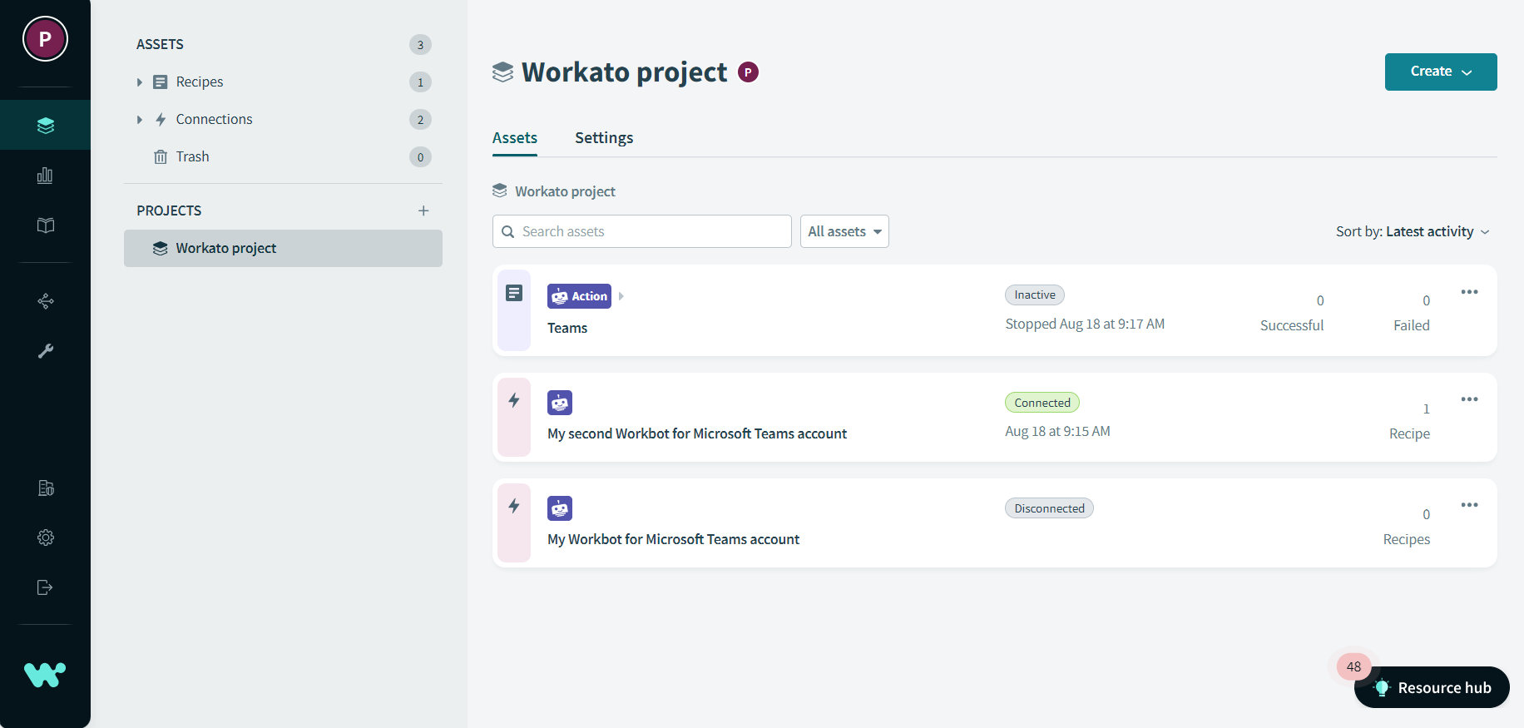
Notes:
Login to Workato and give a small walk through
Initially had reservations on sharing these details but Sitecore themselves say that it’s white labeled version of Workato had some agreements.

Slide 10
Terminologies

Slide 11
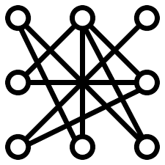
ASSETS
RECIPES
ACTIONS
CONNECTIONS
TRIGGERS
Are like pipelines - DevOps pipelines or Marketing Automation Pipelines. Each recipes when turned on, will be configured to be triggered by a trigger event followed by set of actions/decisions and call functions that allow integrated complex workflow between platforms and data.
Involve calling action in an app. There are several apps listed in connect.
Connections include setting up authentication with different apps.
Basic UserId/Password, OAuth2, JWT, SAML2, Header Auth, Security Keys, API Tokens.
Determine what event to listen to. Required for recipes to work and enables the connection to share data.
Notes:
Trigger Mechanism( Polled, Real Time, Scheduled), Dispatch (Single, Batch/Bulk), Event Type (Created, Updated, Deleted)

Slide 12
NEED FOR CONNECT…..

Slide 13
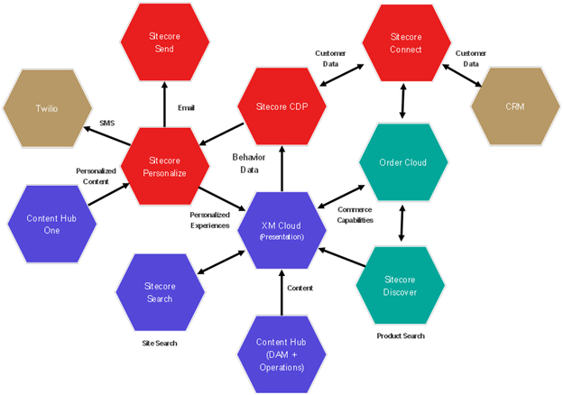
Image Source: https://blogs.perficient.com/files/Sitecore-Cloud-Architecture.png
2023
13

Slide 15
……..In a Version Less Composable World

Slide 16
Notes:
Version Less – Only Feature Drops

Slide 17
DEMO

Slide 18
Some Learning resources
Workato | Automation Institute | All courses - https://academy.workato.com/
Sitecore Connect - https://developers.sitecore.com/integrations/connect
Introduction to Sitecore Connect | Sitecore Documentation - https://doc.sitecore.com/connect/en/users/sitecore-connect/introduction-to-sitecore-connect.html

Slide 19
THANK YOU
Pushpaganan Nagarajan
pushpaganan@hotmail.com
https://pushpaganan.home.blog

