Slide 1


KICK OFF EVENT
SITECORE USER GROUP PUNE MAY 23, 2020

Slide 2


Welcome to our first meetup!
12:00 – 12:05 | Welcome
12:05 – 12:20 | Introduction
12:25 – 1:05 | Sitecore SXA: Yet another Introduction
1:05 – 1:20 | Questions & Answers
1:20 – 1:30 | Thank you

Slide 3
Who are we? & Why Us?
With great guidance from the founders of SUG Bangalore (Anindita Bhattacharya & Gopikrishna Reddy Gujjula), we finally brought the idea into reality of connecting Pune’s Sitecore community together for the greater good.
Who are We?
We are developers, architects, designers, Sitecore professionals, Marketing teams who are passionate about Sitecore, who meet together online or offline for Webinars or to share the experience in Sitecore field.
Why Us?
Great platform to show case your knowledge by presenting in Webinars or meet ups.
As you proceed in your Sitecore journey you might face challenges or obstacles then SUG Pune family is always there to help.
A perfect place to connect with Pune’s Sitecore professionals.

Slide 4

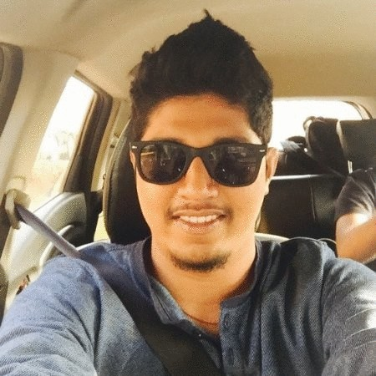
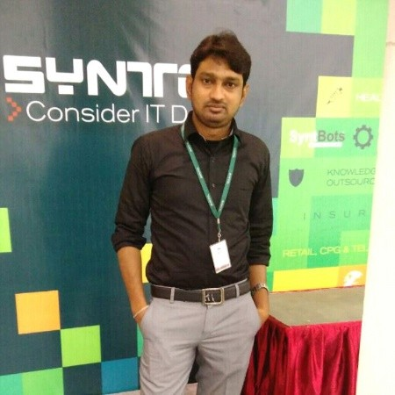
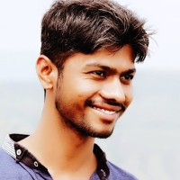
Your group organizers
Rohan Kenkre
Cybage Software
SYSTEM ANALYST
Sandeep Patil
Hexaware Technologies
TECHNICAL ARCHITECT
Vinod Chavan
Infosys
SR. ASSOCIATE CONSULTANT

Slide 5
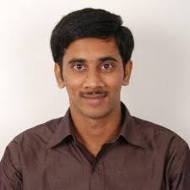
Today’s Speaker
Gopikrishna Reddy Gujjula
Sitecore Technology MVP 2018-2020
Sitecore XP 9.2 Certified
Senior Sitecore Developer at AKQA
Blogs: https://gopigujjula.dev/
LinkedIn: https://nz.linkedin.com/in/gopigujjula
Twitter: https://twitter.com/gopigujjula

Slide 6
Sitecore SXA: Yet another Introduction

Slide 7

Questions & Answers

Slide 8




What’s next?
Next Webinar: We are targeting 2 webinars in June, the topics & the update will be available soon on the Events page of SUG Pune website.
Link: https://sugpune.in/events/
Follow us on Twitter! Look for @sugpune
Join the group on LinkedIn too! Look for “Sitecore User Group Pune”
Also follow our page on Facebook! Look for “sugpune”

